Slide 1
Speech Recognition Dataset
Steeve Huang

Slide 2
Experiments
Image Processing algorithms suggested by George.
Google Cloud Vision API - BETA
Data collection pipeline almost complete (except audio-text alignment)
Discussed with Speech Recognition Team

Slide 3
George’s Suggestion
Background Subtraction (BGS)
Entropy Threshold
Close Area
Histogram Equalization

Slide 4
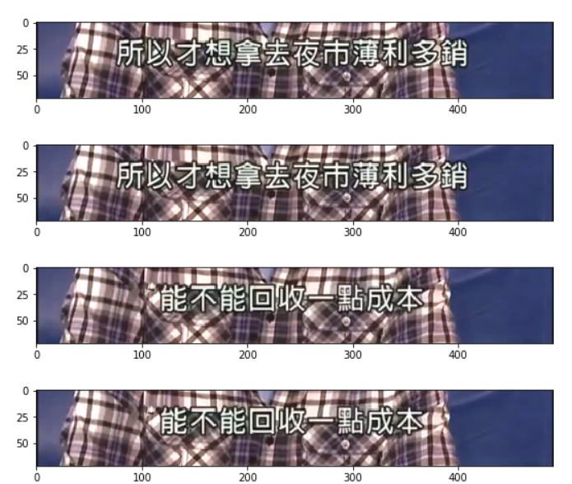
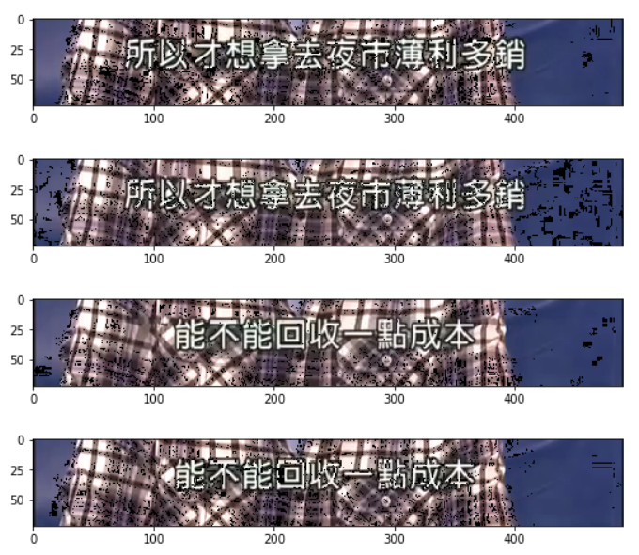
Background Subtraction
Subtract the current by the previous frame. (Sample Rate = 5 1/sec)

Slide 5
Entropy Threshold
Based on the assumption that the horizontal and vertical lines in the image tend to have larger entropy.

Slide 6
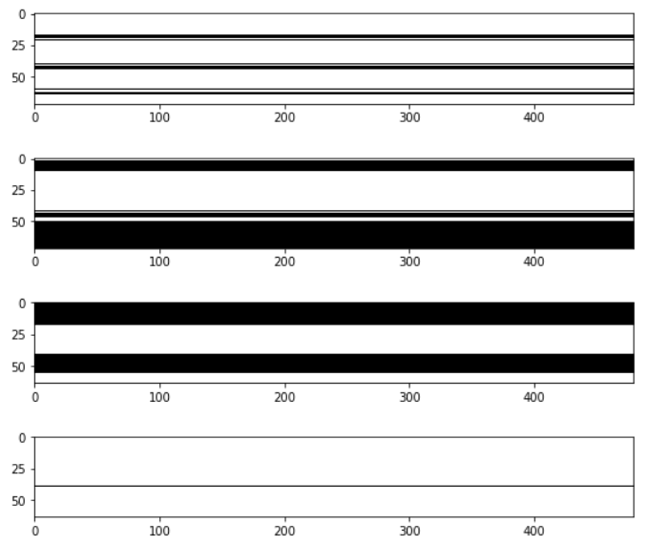
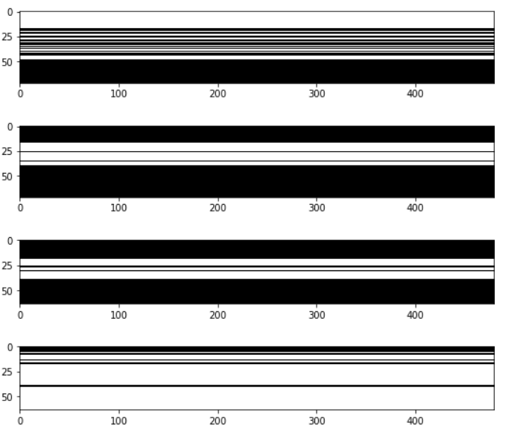
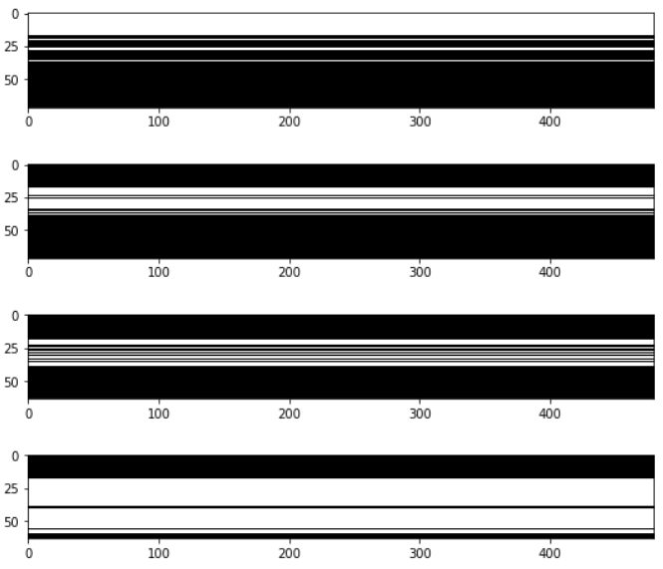
Entropy Threshold
Threshold = 100
Threshold = 150
Threshold = 180

Slide 7
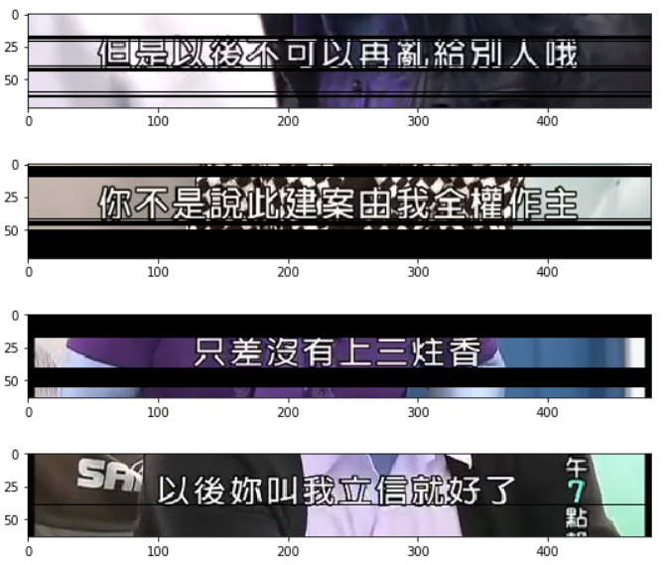
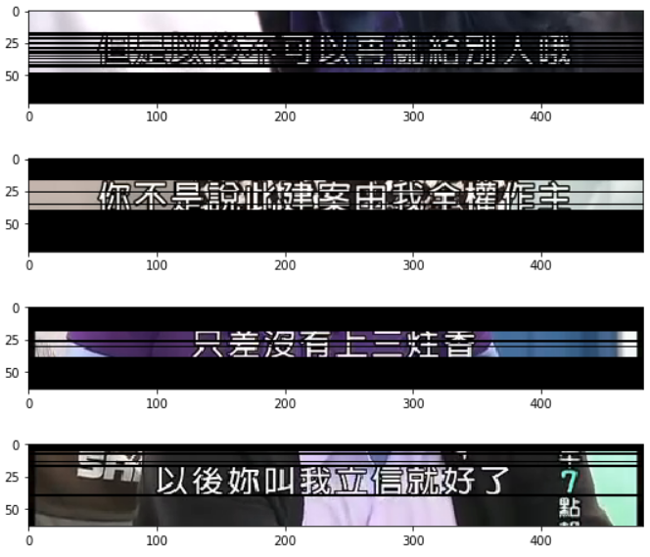
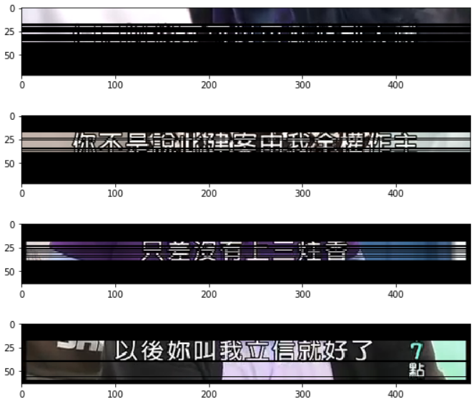
Entropy Threshold
Threshold = 100
Threshold = 150
Threshold = 180

Slide 8
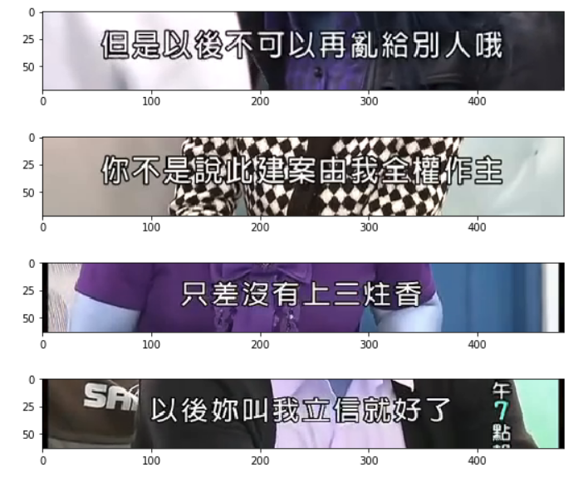
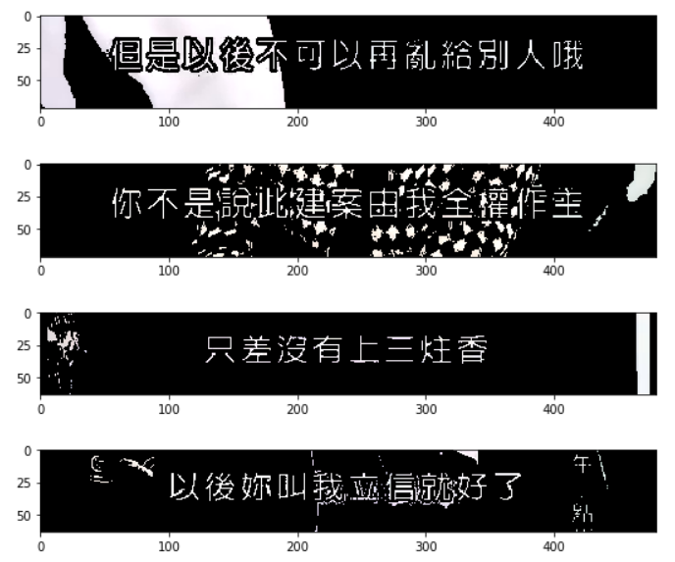
Close Area
Subtitle words are not of the same color.

Slide 9
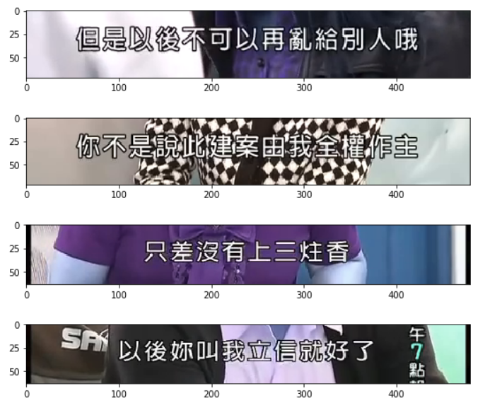
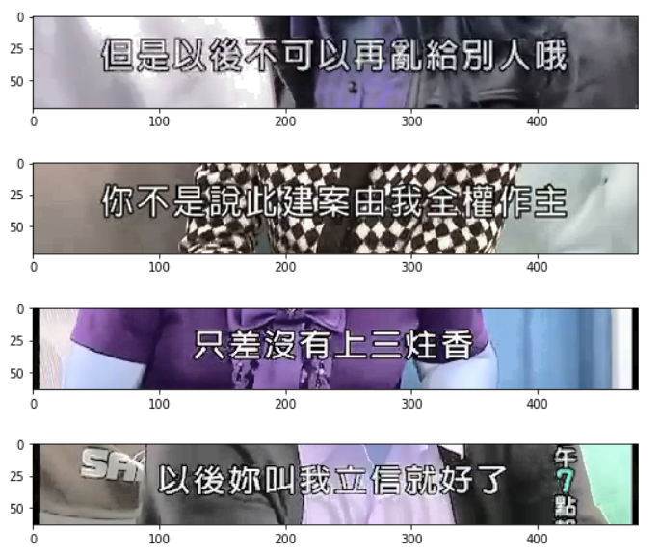
Histogram Equalization

Slide 10
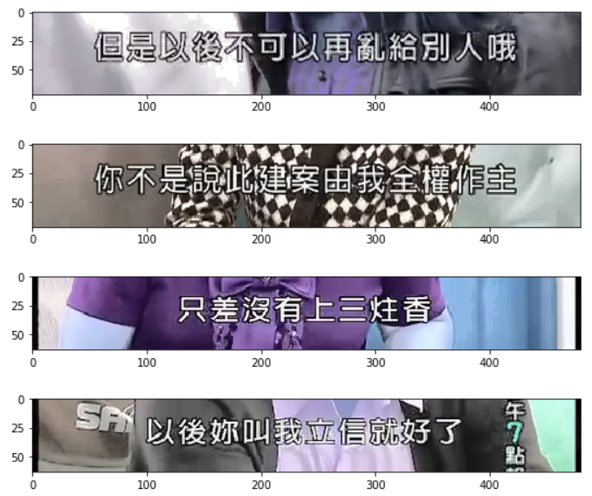
Histogram Equalization
但是以後n可以再亂給別人哦
NA
只差沒侑上三炷香
以後妳叫n立信就n放子了

Slide 11
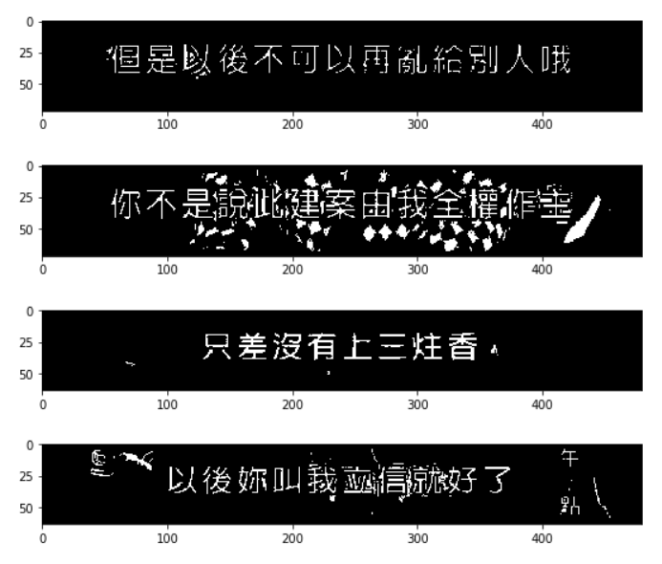
Histogram Equalization
但是以後不可以再亂給別人哦
你不是說:itlaǐ俟宙哦雄:作生
只差沒有上三炷香
午n以後妳叫我血 信n:好了

Slide 12
Document Text Detection
Another reason for not detecting well may because these are typed font rather than text appearing in the context of the image.
-> switch to document text detection

Slide 13
Document Text Detection
但是以後不可以再亂給別人。
你不是說此案由我全權重
只差沒有上三柱香,
Airit 以後妳叫我立信就好了n午5點

Slide 14
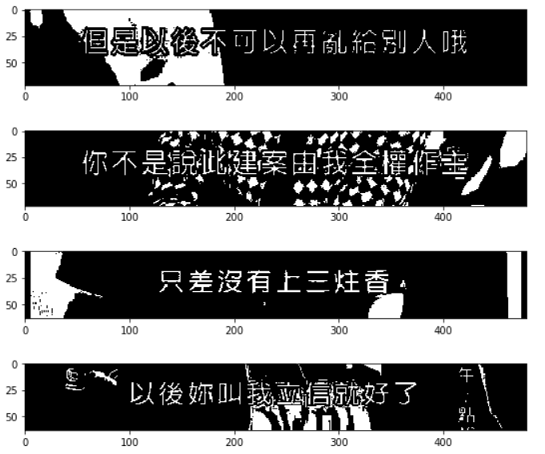
Histogram Equalization & Document Text Detection
但是以後不可以再亂給別人。
你不是說此案由我全權重
只差沒有上三柱香,
Airit 以後妳叫我立信就好了n午5點

Slide 15
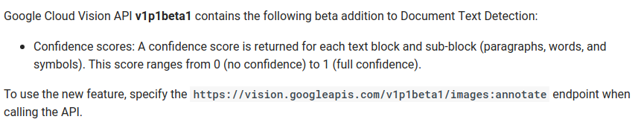
Google Cloud API - BETA

Slide 16
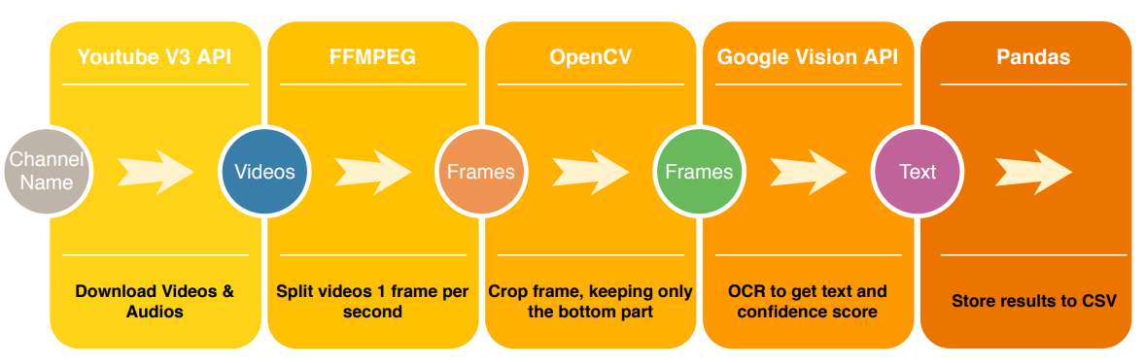
Data Collection Pipeline

Slide 17
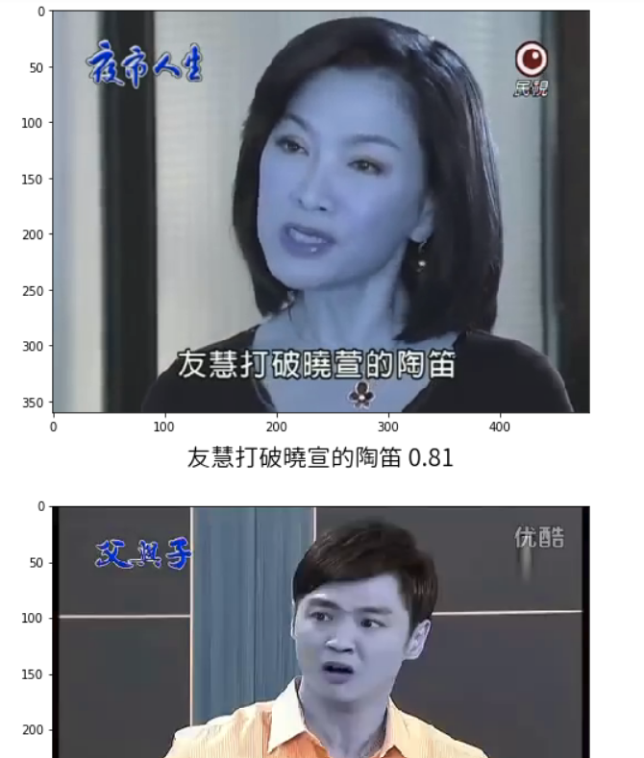
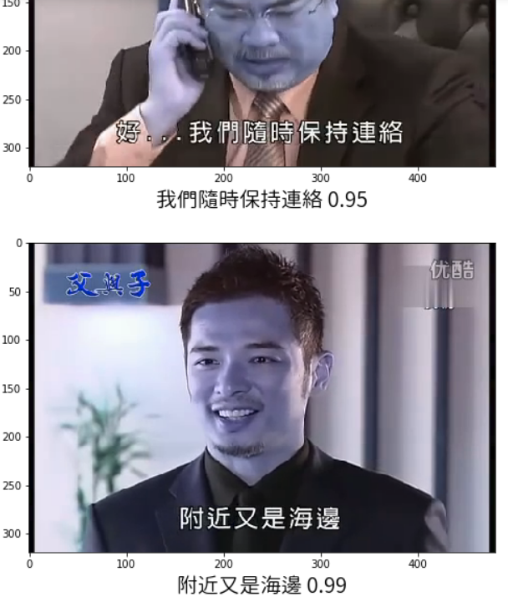
Manual Labelling

Slide 18
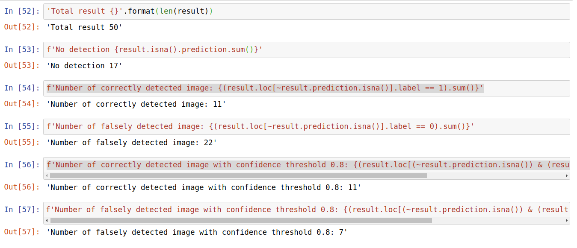
Error Analysis

Slide 19
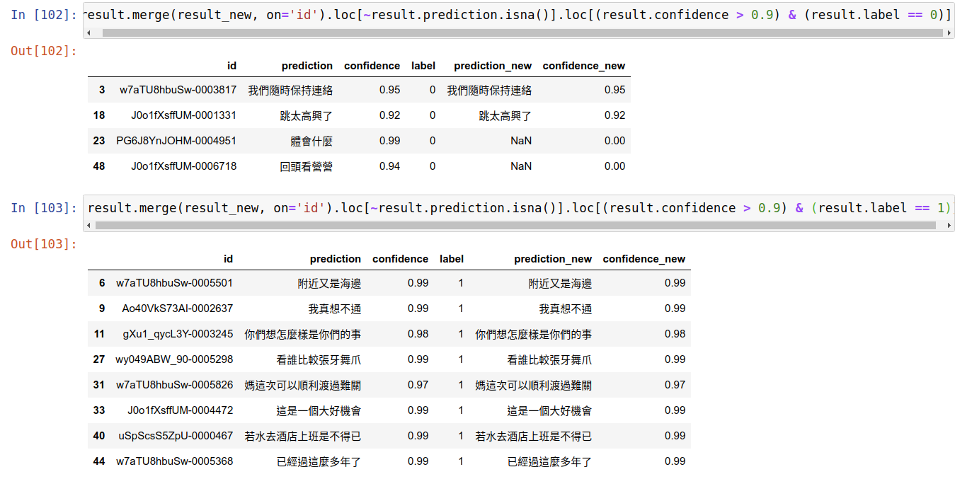
Post-processing (bounding box x-axis)

Slide 20
Test Time Augmentation (TTA)
Augement the images before sending request to Google API.
RGB Shift
Histogram Equalization
Resizing
Rotation
…
Output “True” if the TTAed prediction and the original prediction match.

Slide 21
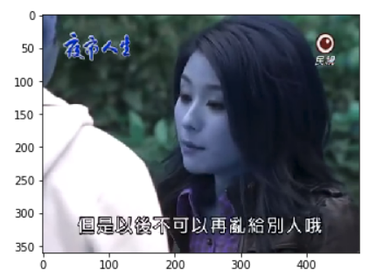
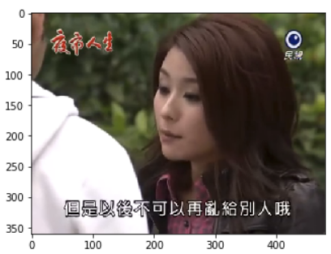
RGB Shift

Slide 22
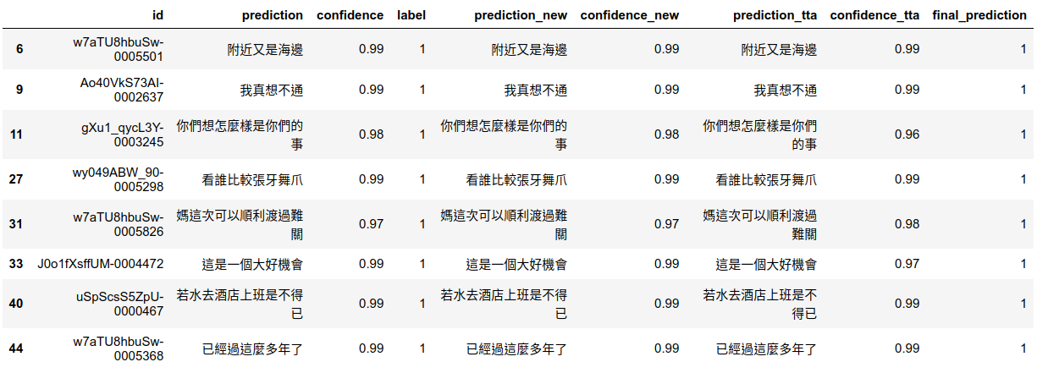
Test Time Augmentation (TTA)

Slide 23
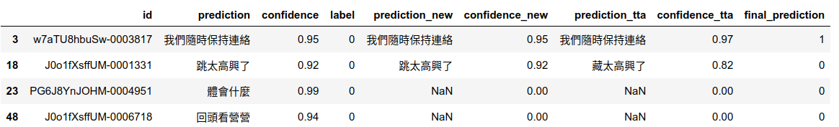
Test Time Augmentation (TTA)

Slide 24
Final Analysis
Total Image: 50
True positive: 8
False positive: 1
-> A 1 hour video (3600 images) -> 576 correct images & 72 wrong images

Slide 25
Discussion with Speech Recognition Team
Instead of outputing csv files, generate srt format output.
Increase frame rate.
Detect text before sending to Google OCR API.
Variable confidence threshold.
They have their models for aligning text and speech, but currently do not support Taiwanese speech segmentation.

Slide 26
Next Step
Use self-trained character detection model to save money
Increase True Negative rate
Mask-RCNN can both denoise as well as detect characters.

Slide 27
Appendix

Slide 28
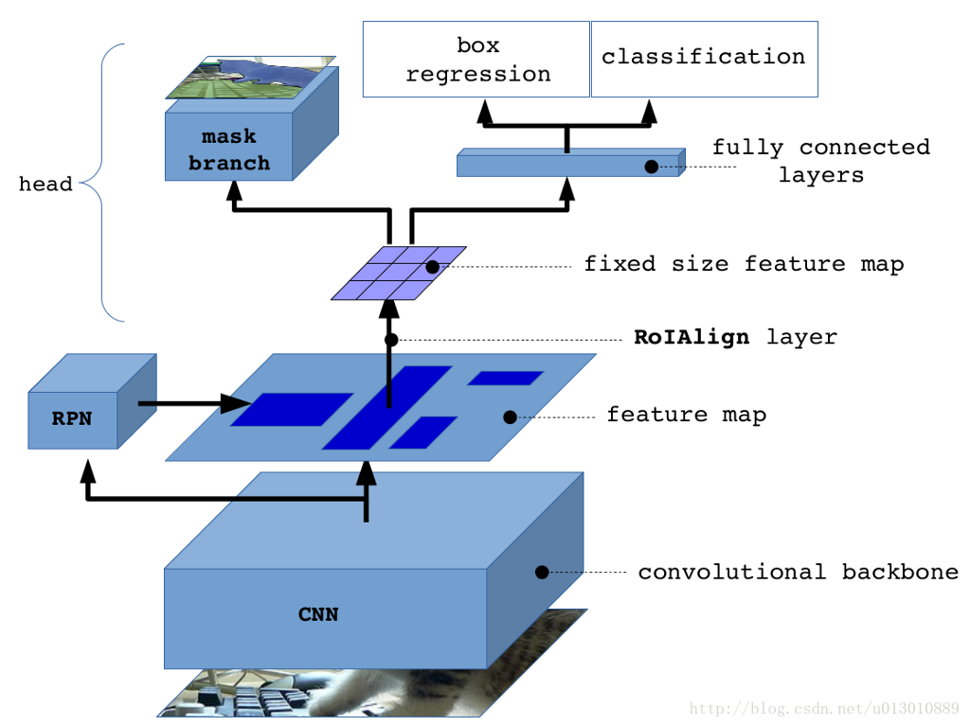
Mask-RCNN

Slide 29
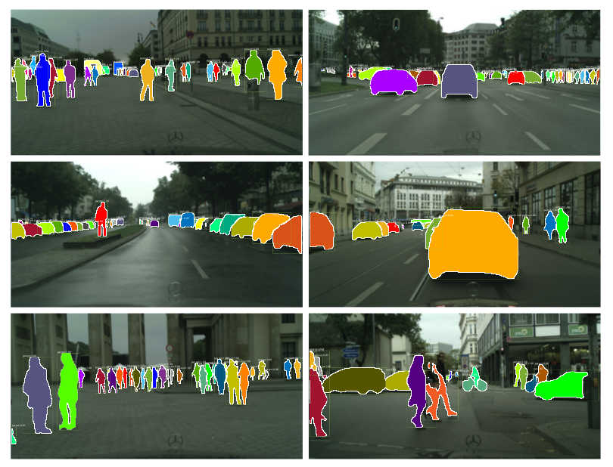
Mask-RCNN

Slide 30
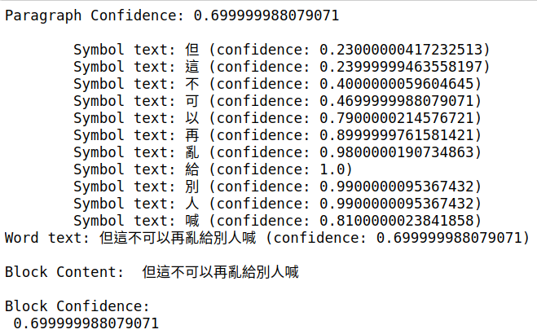
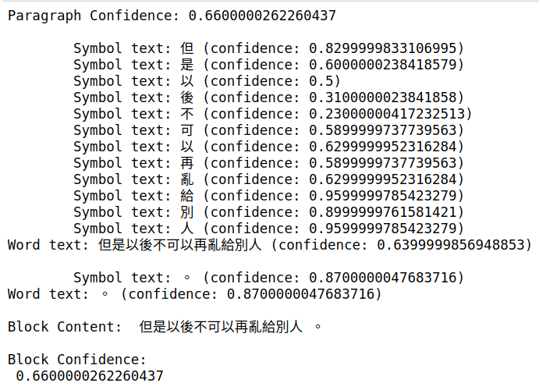
Histogram Equalization - Google Cloud API BETA
Raw Histogram Equalization

Slide 31
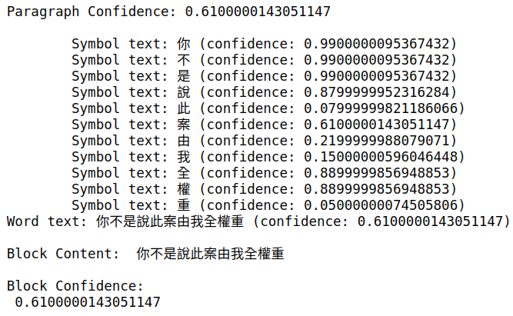
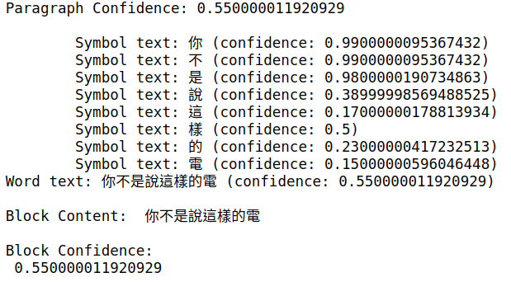
Histogram Equalization - Google Cloud API BETA
Raw Histogram Equalization

Slide 32
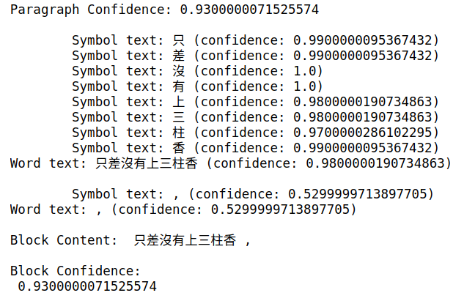
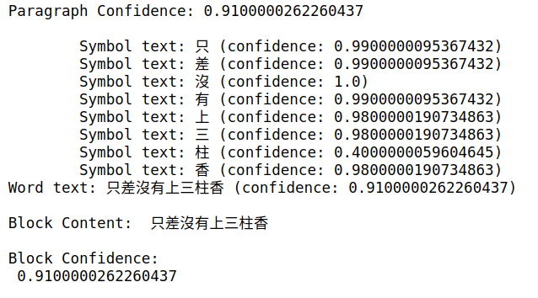
Histogram Equalization - Google Cloud API BETA
Raw Histogram Equalization

Slide 33
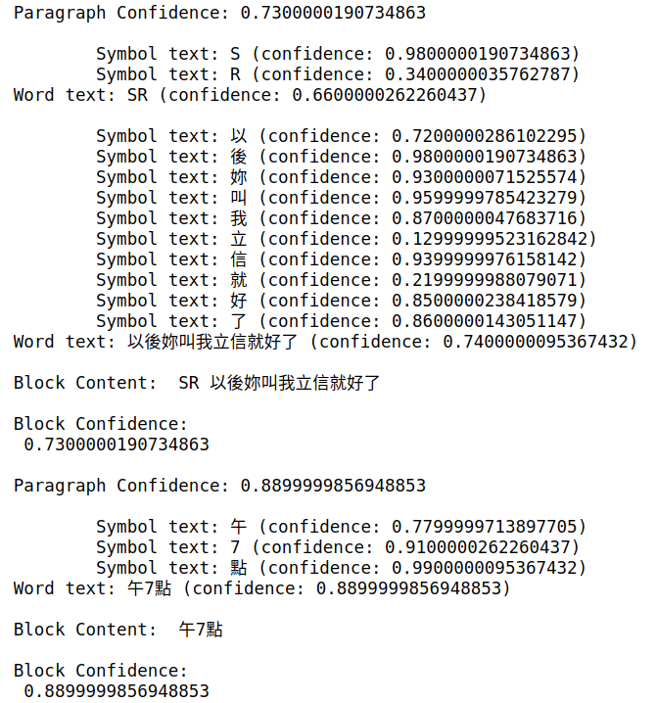
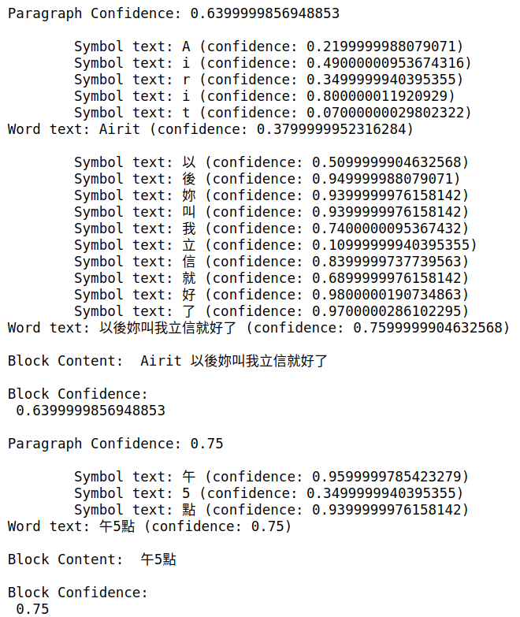
Histogram Equalization - Google Cloud API BETA

